Slide 1
Films Catalogue
Developed and Presented By
Christie Hyde, Zhenming Wang and Christopher von Altenstadt

Slide 2
Find movies that you will enjoy

Slide 3
Concept
A search engine webpage to find information about movies that the viewer has interest in
Motivation: to help create interest in movies that people may not know much about but have interest in
AS A movie consumer
I WANT to see rating and reviews of movies
SO THAT I can find what I want to watch

Slide 4
Process
Technologies used: HTML, CSS, JavaScript, OMDB API
Team Roles:
Project Manager, API Specialist and Cleanup: Christie
HTML and CSS Styler: Zhenming
Backend Developer: Christopher
Challenges: second API, number of search results
Successes: reading API data, HTTPS

Slide 5
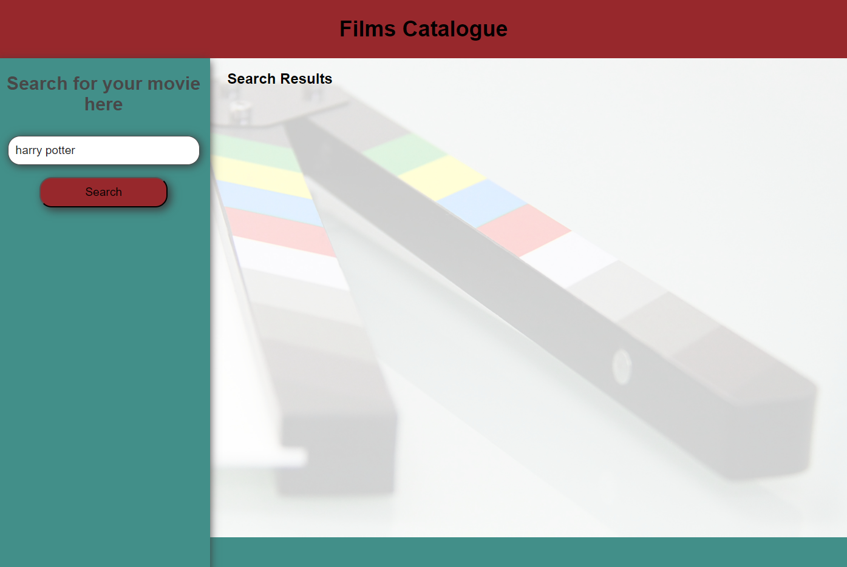
Demo
https://christiehyde.github.io/FilmsCatalogue/

Slide 6
Directions for Future Development
Increase number of search results
Increase search criteria
Implement second API
Watch list
Language support

Slide 7
Links
Live site: https://christiehyde.github.io/FilmsCatalogue/
GitHub repository: https://github.com/ChristieHyde/FilmsCatalogue
All movie data displayed on this site is obtained from the Open Movie Database (OMDB - https://www.omdbapi.com/) in accordance with their licensing agreement under CC BY-NC 4.0.

